Slide 1

MOTIONMATRIX:
A HAND ACTIVITY DETECTION SYSTEM
By:
Kazi Farhana Faruque (Roll: 1506)
Md. Musfiqur Rahman Shishir (Roll: 1521)
Supervisor: Prof. Dr. Mohammad Shoyaib
1

Slide 2

Motivation
The garments sector plays a vital role in the national economy. However many factories still rely on manual processes for tracking worker productivity, attendance, performance, and efficiency. This often leads to mismanagement and low productivity.
Our system will help floor managers to track daily activities, analyze worker performance and schedule shifts efficiently. The owner and managers will be provided data-driven insights.
2

Slide 3



MotionMatrix (MM) is a web-based application
Project Description
It is designed to enhance efficiency
in garment factories by automating activity tracking and performance monitoring.
It addresses issues like:
• Manual record-keeping
• Lack of real-time insights
• Key functionalities include worker scheduling and productivity analysis.
3

Slide 4


Normal Features
Face recognition of workers.
Worker’s Hand activity detection.
Time measurement based on whether the worker is active or idle.
Create or remove profiles for the workers.
Generate various types of reports.
4

Slide 5
Exciting Features
Real-time notifications for inactivity
Overtime management
Messaging system for replacement requests
5

Slide 6
Divide project into independent modules
Strategy
& Development Plan
Parallel development of modules
Pair programming for interdependent parts
6

Slide 7

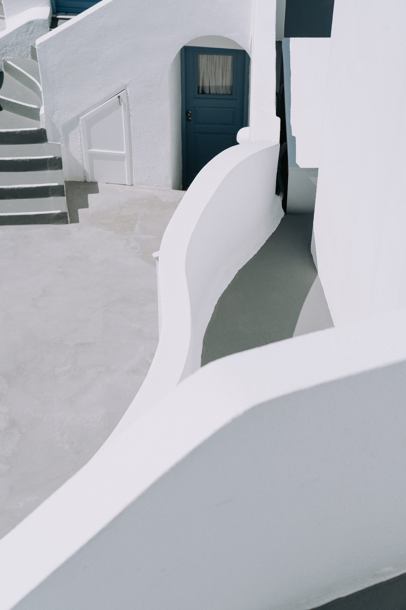
Development Timeline (12 Weeks)
•Week 1–3:
SRS Documentation
•Week 9–11:
Face & Hand Recognition
•Week 4–8: Learning and UI Design
•Week 12:
Testing and Deployment
7

Slide 8





LANGUAGES AND TOOLS
React
Django
MySQL
GitHub
8

Slide 9
Thank you very much!
9

